Slide 1


OPERATING SYSTEM
INSY 8223
Faculty of IT, GROUP D&F
Dr Eric NIZEYIMANA, Mr. NSHIMYUMUREMYI Gilbert and Mr. Archimede IRAKOZE
eric.nizeyimana@auca.ac.rw| +250 783 308 544 | nshimyu8@yahoo.fr +250783219523

Slide 2
Lesson 4. Inter-Process Communication (IPC)

Slide 3
Introduction to Inter process Communication
Inter Process Communication (IPC) constitutes a mechanism commonly provided by the operating system (OS).
Its fundamental objective is to streamline communication between diverse processes.
In brief terms, IPC empowers one process to inform another process about the occurrence of an event.
It helps processes synchronize their activities, share information, and avoid conflicts while accessing shared resources.
What is IPC?
IPC = Inter-Process Communication
Explain:
A process = a running program
IPC allows processes to:
  exchange data
  work together

Slide 4
Cont’
IPC allows processes to exchange data and synchronize actions.
Why IPC Needed because?: -Data sharing
-Speed
Processes may run in parallel.
They often need to share data or coordinate execution.
Examples: Chat apps, file sharing, web browsers.

Slide 5
What is Inter Process Communication in OS?
IPC is a mechanism that allows processes to communicate and synchronize their actions.:
Two main models:
Shared Memory
  Processes use the same memory space
  Very fast
Message Passing
  Processes send messages to each other
  Safer and easier
  Which one is faster? → Shared memory
Inter-process communication (IPC) serves as a means for transmitting data among multiple threads situated within one or more processes or programs. These processes may be active on a solitary computer or distributed across a network of machines (Processes can be on the same computer or on different computers).
It is a set of programming interfaces that enable a programmer to coordinate actions across multiple processes that can run concurrently in an operating system. This enables a given program to handle several user requests at the same time.
Because each user request may cause multiple processes to operate in the operating system, the processes may need to communicate with one another. Because each IPC protocol technique has its own set of advantages and disadvantages, it is not uncommon for a single program to use many protocols.

Slide 6
TYPES OF PROCESS IN IPC
Independent process: An independent process is not affected by the execution of other processes. Independent processes are processes that do not share any data or resources with other processes. No inte-process communication required here.
Co-operating process: Interact with each other and share data or resources. A co-operating process can be affected by other executing processes. Inter-process communication (IPC) is a mechanism that allows processes to communicate with each other and synchronize their actions. The communication between these processes can be seen as a method of cooperation between them.
Example: Printing system
Client ↔ Server

Slide 7
Synchronization in Inter Process Communication
When processes share data:
⚠️ They may access it at the same time
➡️ This causes race condition
Synchronization means:
Control who uses the resource and when.
Example: two students editing the same documents at same time.
Within the realm of Inter Process Communication in an operating system, synchronization assumes a crucial role. It guarantees that processes engage in communication and harmonize their actions with security and meticulousness.
The subsequent techniques exemplify synchronization methodologies employed in IPC:
Semaphores
Mutexes
Monitors
Condition Variables

Slide 8

1.Semaphore
A semaphore = a signaling variable
Used to:control access to shared resources
Two types:Binary semaphore (0 or 1)
Counting semaphore
Operations:
wait()
signal() Real-Time example: Traffic rights
A semaphore is a signaling mechanism that uses an integer value to control access to shared resources. There are two types: binary (0 or 1) and counting (with a range of values). Semaphores support two operations:
Wait (P): Decreases the semaphore value. If the value is less than or equal to zero, the process waits.
Signal (V): Increases the semaphore value, potentially waking up a waiting process.
Example: Controlling access to a printer where only one process can use it at a time. A binary semaphore ensures that if one process is printing, others must wait until the printer becomes available.

Slide 9
2. Mutexes
A mutex is a locking mechanism that ensures only one thread or process accesses a critical section at a time. It works like a binary semaphore but is specifically designed for locking and unlocking.
Lock: A thread locks the mutex before entering the critical section.
Unlock: The thread unlocks the mutex after exiting the critical section. Example:
Example: Protecting access to a shared counter variable. A mutex ensures that only one thread can increment or read the counter at a time.
Only ONE process can enter the critical section at a time.
Real-life Example:
One key for one room
If a student has the key → others must wait.

Slide 10
3. Monitors
A monitor is a high-level synchronization construct that encapsulates (sum up) shared variables, mutexes, and condition variables.
It provides a safe way to manage concurrent access by ensuring that only one process or thread is active in the monitor at any given time.
Example: In a bank account system, a monitor might encapsulate the account balance and the functions for deposit and withdrawal, ensuring that updates to the balance are managed correctly when accessed by multiple threads.

Slide 11
4. Condition Variables
A condition variable is used with mutex/monitor to:
✔ make a process wait
✔ wake it up when a condition becomes true
Operations:
wait() → sleep until condition is true
signal() → wake one process
broadcast() → wake all
Example: A process waits until the buffer is not empty.
A condition variable allows threads to wait until a specific condition is met. It works alongside a mutex within a monitor. Threads can be put to sleep (wait) if a condition is not met and woken up (signal) when the condition changes.
Example: A producer-consumer problem where the producer waits if the buffer is full (using a condition variable) and signals the consumer when data is added to the buffer.

Slide 12
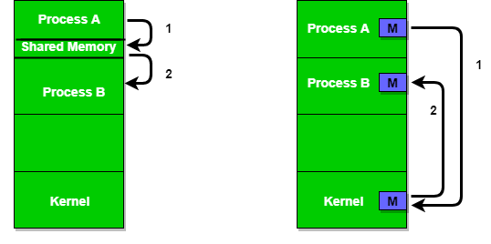
Approaches for Inter Process Communication in OS
The two fundamental models of Inter Process Communication are:
1. Share Memory 2. Message Passing
1. Shared Memory
Processes use the same memory.
2.Message Passing
Processes send and receive messages.

Slide 13
1. Pipes
Pipes is a method of Inter Process Communication in OS that allows processes to communicate with each other by reading from and writing to a common channel, which acts as a buffer between the processes.
Pipes can be either named or anonymous, depending on whether they have a unique name or not.
Named pipe is a type of pipe that has a unique name, and can be accessed by multiple processes. Named pipes can be used for communication between processes running on the same host or between processes running on different hosts over a network.

Slide 14
Cont’
Anonymous pipes, on the other hand, are pipes that are created for communication between a parent process and its child process. Anonymous pipes are typically used for one-way communication between processes, as they do not have a unique name and can only be accessed by the processes that created them.
In IPC, pipes can be used for a variety of purposes, such as exchanging data between processes, coordinating the activities of multiple processes, and implementing pipelines, which are sequences of processes that communicate with each other through pipes.

Slide 15
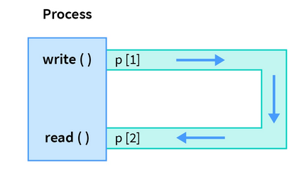
Cont’
The use of pipes in IPC is a simple and efficient method of communication, as they provide a way for processes to exchange data without the overhead of more complex IPC methods, such as sockets or message passing. However, pipes have limited capabilities compared to other IPC methods, as they only support one-way communication and have limited buffer sizes.

Slide 16
2. Message Passing
Message passing is a method of Inter Process Communication in OS. It involves the exchange of messages between processes, where each process sends and receives messages to coordinate its activities and exchange data with other processes. Each process sends messages to the others via Kernel.
In message passing, each process has a unique identifier, known as a process ID, and messages are sent from one process to another using this identifier. When a process sends a message, it specifies the recipient process ID and the contents of the message, and the operating system is responsible for delivering the message to the recipient process. The recipient process can then retrieve the contents of the message and respond, if necessary.

Slide 17
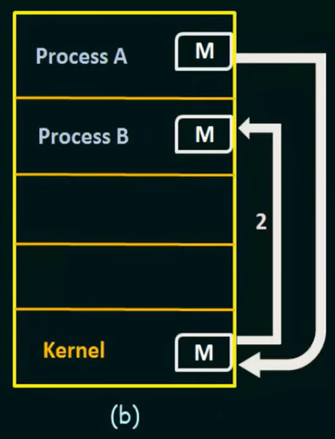
Cont’
The main advantage of message passing is that it provides a flexible and scalable method of communication between processes, as processes can communicate with each other even if they are running on different hosts or in different network domains. Additionally, message passing provides a way for processes to communicate without being tightly coupled, as the sender and receiver processes do not need to share any common resources or have a direct connection.
However, message passing also has some disadvantages, such as increased overhead due to the need to copy messages between address spaces, and the possibility of message loss or corruption due to network failures or other system issues.

Slide 18
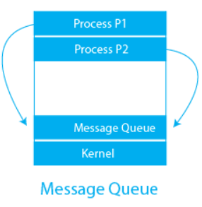
3. Message Queue
Message Queue is a method of Inter Process Communication in OS that involves the use of a shared queue, where processes can add messages and retrieve messages for communication. The queue acts as a buffer for the messages and provides a way for processes to exchange data and coordinate their activities.
In Message Queue IPC, each message has a priority associated with it, and messages are retrieved from the queue in order of their priority. This allows processes to prioritize the delivery of important messages and ensures that critical messages are not blocked by less important messages in the queue.

Slide 19
Cont’
Message Queue IPC provides a flexible and scalable method of communication between processes, as messages can be sent and received asynchronously, allowing processes to continue executing while they wait for messages to arrive. Additionally, Message Queue IPC supports the communication between processes running on different hosts, as the message queue can be implemented as a network service.
The main disadvantage of Message Queue IPC is that it can introduce additional overhead, as messages must be copied between address spaces, and the queue must be managed by the operating system to ensure that it remains synchronized and consistent across all processes.

Slide 20
Message Passing Vs. Message Queues
Message Passing is a general IPC mechanism where processes communicate by sending and receiving messages. It can be synchronous (blocking) or asynchronous (non-blocking).
Message Queues are a specific IPC mechanism that allows processes to send messages to a queue, where they are stored until the receiving process retrieves them. This provides asynchronous communication, meaning the sender and receiver do not need to interact simultaneously.
In short, Message Queues are a type of Message Passing that provides buffered, asynchronous communication.

Slide 21
4. Shared Memory
Shared memory is a method of Inter Process Communication in OS that involves the use of a shared memory region, where multiple processes can access the same data in memory. Shared memory provides a way for processes to exchange data and coordinate their activities by accessing a common area of memory.
In shared memory IPC, the operating system sets up a shared memory region and maps it into the address spaces of the processes that need to access it. Each process can then read and write to the shared memory region, allowing them to exchange data and coordinate their activities.

Slide 22
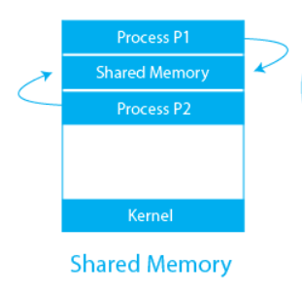
Cont’
Shared memory IPC provides a high-performance method of communication between processes, as it eliminates the need to copy data between address spaces and allows processes to access the same data in memory. This makes shared memory IPC particularly useful for applications that need to exchange large amounts of data, such as multimedia applications or scientific simulations.
However, shared memory IPC also has some limitations, as it requires processes to coordinate their access to the shared memory region to ensure that it remains synchronized and consistent. Additionally, shared memory IPC can introduce security risks, as processes can potentially access and modify data in memory that they should not have access to.

Slide 23
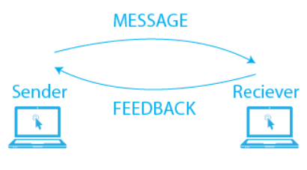
5. Direct Communication
Direct communication is a method of Inter Process Communication in OS. It involves the direct exchange of data between processes, without the use of intermediate communication mechanisms such as message passing, message queues, or shared memory.
In direct communication, processes communicate with each other by exchanging data directly, either by passing data as parameters to function calls or by reading and writing to shared data structures in memory. Direct communication is typically used when processes need to exchange small amounts of data, or when they need to coordinate their activities in a simple and straightforward manner.

Slide 24
Cont’
The main advantage of direct communication is that it provides a simple and direct way for processes to communicate, as processes can access each other’s data directly without the need for intermediate communication mechanisms. This can result in lower overhead and improved performance, as data does not need to be copied between address spaces.
However, direct communication also has some limitations, as it can lead to tight coupling between processes, and it can make it more difficult to change the communication mechanism in the future, as direct communication is hardcoded into the processes themselves. Despite these limitations, direct communication remains a popular and widely used method of IPC in operating systems.

Slide 25
6. Indirect Communication
Indirect communication is a method of Inter Process Communication in OS. It involves the use of intermediate communication mechanisms, such as message passing, message queues, or shared memory, to exchange data between processes.
In indirect communication, processes communicate with each other by adding messages to a shared communication mechanism, such as a message queue or a shared memory region. The communication mechanism acts as an intermediary, allowing processes to exchange data and coordinate their activities in a more decoupled and flexible manner.

Slide 26
Cont’
The main advantage of indirect communication is that it provides a more flexible and scalable way for processes to communicate, as processes do not need to have direct access to each other’s data.
This can result in a more modular and maintainable system, as processes can be developed and maintained independently, and the communication mechanism can be changed or updated without affecting the processes themselves.
However, indirect communication can also introduce additional overhead, as data must be copied between address spaces, and the communication mechanism must be managed by the operating system to ensure that it remains synchronized and consistent across all processes.

Slide 27
7. FIFO
FIFO (First-In-First-Out) is a method of Inter Process Communication in OS that involves the use of a FIFO buffer, which acts as a queue for exchanging data between processes.
In the FIFO method, one process writes data to the FIFO buffer, and another process reads the data from the buffer in the order in which it was written. The FIFO buffer acts as a queue, with the oldest data being read first, and the newest data being added to the end of the queue.

Slide 28
Cont’
The main advantage of the FIFO method is that it provides a simple and straightforward way for processes to communicate, as data is exchanged in a sequential manner, and there is no need for processes to coordinate their access to the FIFO buffer.
This makes FIFO particularly useful for applications that need to exchange data in a sequential manner, such as printing applications or pipeline-based processing systems.
However, the FIFO method can also introduce limitations, as it may result in slow performance if the buffer becomes full and data must be written to the disk, or if the buffer becomes empty and data must be read from the disk.
Additionally, the FIFO method is limited in terms of the amount of data that can be exchanged, as the buffer has a finite size.

Slide 29
Grouping of IPC Mechanisms as Direct or Indirect
Direct IPC | Indirect IPC
Pipes – Direct communication between related processes. | Named Pipes (FIFOs) – Uses a named intermediary for unrelated processes.
Sockets – Enables direct communication over a network or between local processes. | Message Queues – Uses an intermediary queue to store and transfer messages.
Message Passing – Processes send messages directly to each other. | Mailboxes/Ports – Messages are sent to an intermediary and retrieved later.
Shared Memory – Processes access the same memory space without synchronization. | Shared Memory (with Semaphores/Mutexes) – Uses synchronization mechanisms to regulate access.

Slide 30
Why Inter Process Communication (IPC) needed?
Resource Sharing: IPC enables multiple processes to share resources, such as memory and file systems, allowing for better resource utilization and increased system performance.
Coordination and Synchronization: IPC provides a way for processes to coordinate their activities and synchronize access to shared resources, ensuring that the system operates in a safe and controlled manner.
Communication: IPC enables processes to communicate with each other, allowing for the exchange of data and information between processes.

Slide 31
Cont’
Modularity: IPC enables the development of modular software, where processes can be developed and executed independently, and then combined to form a larger system.
Flexibility: IPC allows processes to run on different hosts or nodes in a network, providing greater flexibility and scalability in large and complex systems.
Overall, IPC is essential for building complex and scalable systems in operating systems, as it enables processes to coordinate their activities, share resources, and communicate with each other in a safe and controlled manner. Understanding IPC and its synchronization methods is fundamental for building robust and effective multi-process systems.

Slide 32
Lesson 5. Multithreading and Deadlocks

Slide 33

Thank you
For I know the thoughts that I think toward you, saith the LORD, thoughts of peace, and not of evil, to give you an expected end. Jeremy 29:11

